Slide 1
Lending Club Case Study
Name:
RAJU SHANKAR VITKAR

Slide 2
Lending club Case Study Strategy
Company receives a loan application, the company has to make a decision for loan approval based on the applicant’s profile. Two types of risks are associated with the bank’s decision:
If the applicant is likely to repay the loan, then not approving the loan results in a loss of business to the company
If the applicant is not likely to repay the loan, i.e. he/she is likely to default, then approving the loan may lead to a financial loss for the company

Slide 3
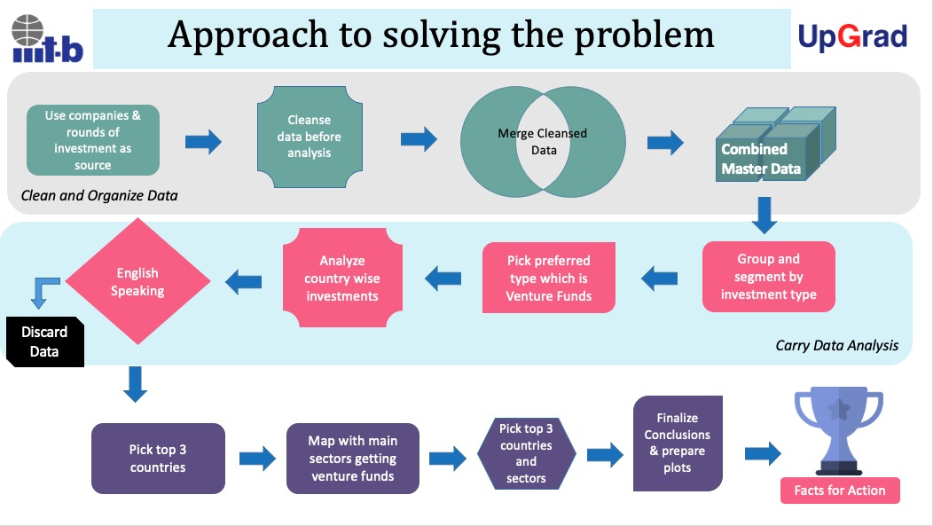

Slide 4
Problem Analysis
Person applies for a loan, there are two types of decisions that could be taken by the company:
Loan accepted: If the company approves the loan, there are 3 possible scenarios described below:
Fully paid: Applicant has fully paid the loan (the principal and the interest rate)
Current: Applicant is in the process of paying the instalments, i.e. the tenure of the loan is not yet completed. These candidates are not labelled as 'defaulted’.
Charged-off: Applicant has not paid the instalments in due time for a long period of time, i.e. he/she has defaulted on the loan
Loan rejected: The company had rejected the loan (because the candidate does not meet their requirements etc.). Since the loan was rejected, there is no transactional history of those applicants with the company and so this data is not available with the company (and thus in this dataset)

Slide 5
STEPS
Data understanding and Sourcing.
Check for Data quality issue and Binning
Check for Data imbalance and univariate, segmented univariate & Bivariate analysis, correlation
Merging of application data with previous application data.
Data analysis by univariate, segmented univariate, Bivariate analysis and correlation
Recommendation and Risks

Slide 6
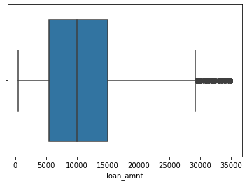
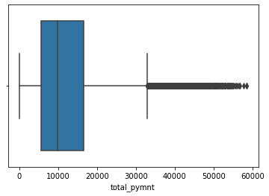
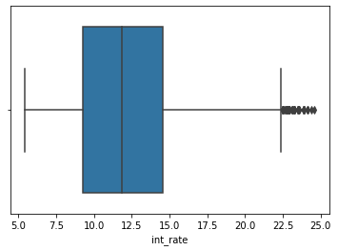
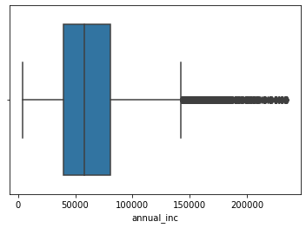
Univariate Analysis

Slide 7
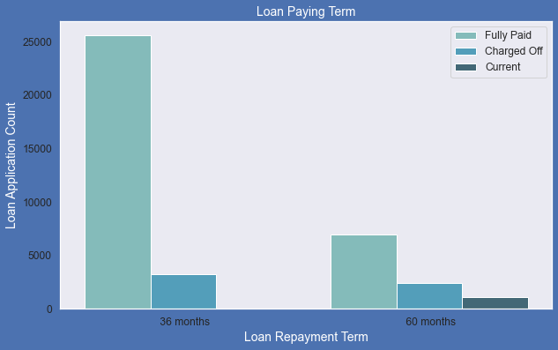
Loan Paying Term
Below plot shows that those who had taken loan to repay in 60 months had more % of number of applicants getting
charged off as compared to applicants who had taken loan for 36 months.

Slide 8
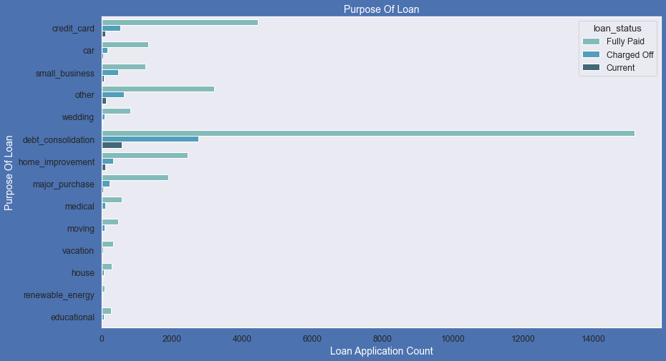
Bivariate Analysis
Below plot shows that most of the loans were taken for the purpose of debt consolidation & paying credit card bill.
Number of chraged off count also high too for these loans.

Slide 9
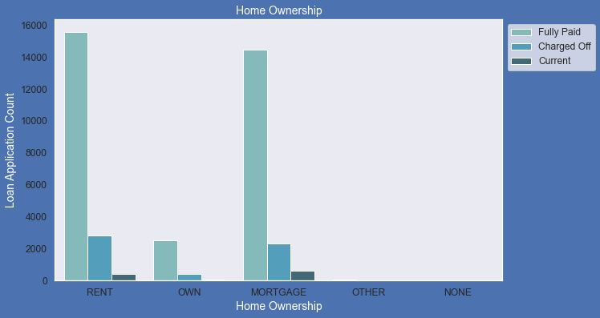
Below plot shows that most of them living in rented home or mortgaged their home. Applicant numbers are high from these categories so charged off is high too.

Slide 10
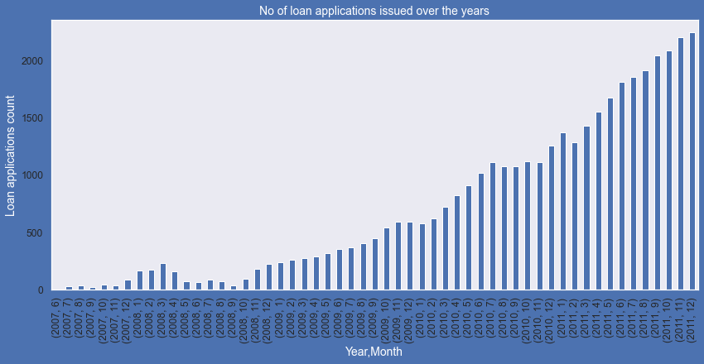
So the increase in number of loan applications are adding more to number of charged off applications. Number of loans issued in 2008( May-October) got dipped, may be due to Recession.

Slide 11
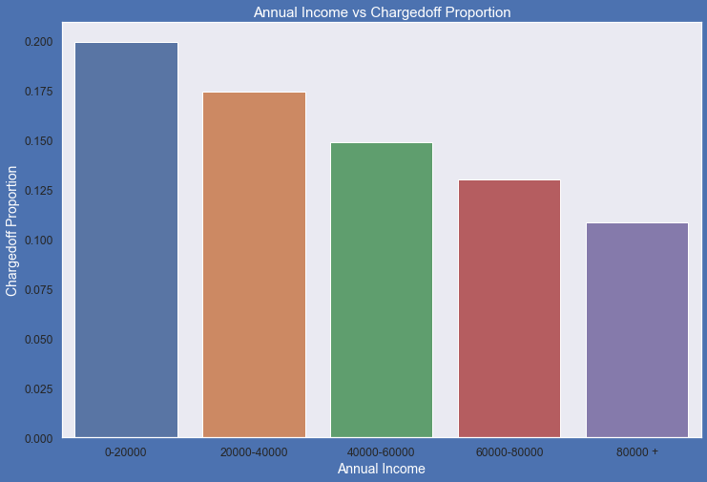
Below are the observations from this plot: 1.Income range 80000+ has less chances of charged off. 2.Income range 0-20000 has high chances of charged off. 3.Notice that with increase in annual income charged-off proportion got decreased.
loan_status | annual_inc_cats | Charged Off | Current | Fully Paid | Total | Chargedoff_Proportion
0 | 0-20000 | 237 | 9 | 943 | 1189 | 0.20
1 | 20000-40000 | 1514 | 170 | 7004 | 8688 | 0.17
2 | 40000-60000 | 1729 | 345 | 9534 | 11608 | 0.15
3 | 60000-80000 | 1024 | 240 | 6597 | 7861 | 0.13
4 | 80000 + | 1080 | 362 | 8531 | 9973 | 0.11

Slide 12
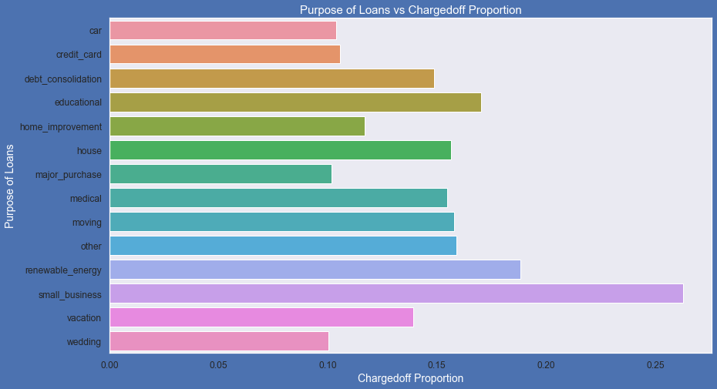
Observations from this plot: 1.small Business applicants have high chances of getting charged off. 2.renewable_energy where charged-off proportion is better as compare to other categories.

Slide 13
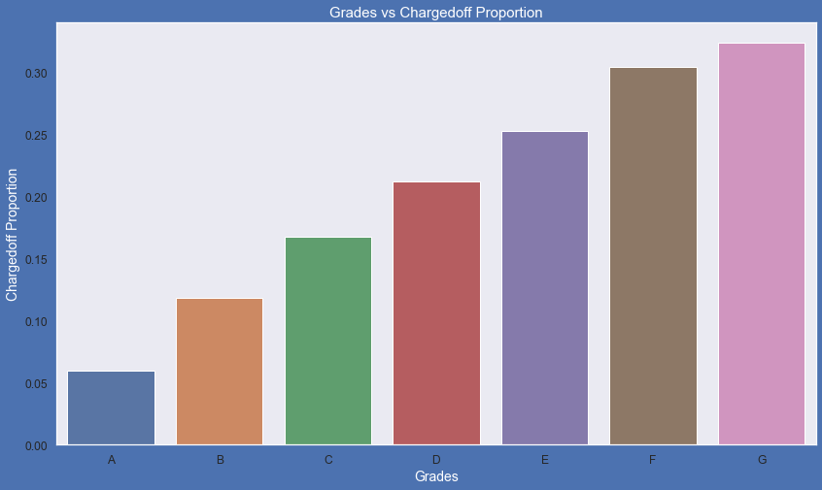
Key Observations: 1.Grade "A" has very less chances of charged off. 2.Grade "F" and "G" have very high chances of charged off. 3.Chances of charged of is increasing with grade moving from "A" towards "G"
loan_status | grade | Charged Off | Current | Fully Paid | Total | Chargedoff_Proportion
6 | G | 99 | 17 | 190 | 306 | 0.32
5 | F | 312 | 71 | 642 | 1025 | 0.30
4 | E | 704 | 176 | 1906 | 2786 | 0.25
3 | D | 1112 | 216 | 3916 | 5244 | 0.21
2 | C | 1342 | 262 | 6411 | 8015 | 0.17
1 | B | 1414 | 344 | 10167 | 11925 | 0.12
0 | A | 601 | 40 | 9377 | 10018 | 0.06

Slide 14
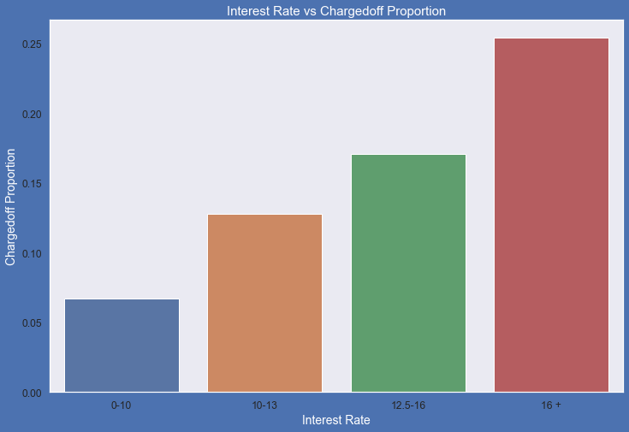
Key points: 1. interest rate less than 10% has very less chances of charged off. Interest rates are starting from minimum 5 %. 2. interest rate more than 16% has good chances of charged off as compared to other category interest rates. 3. Charged-off proportion is increasing with higher interest rates.

Slide 15
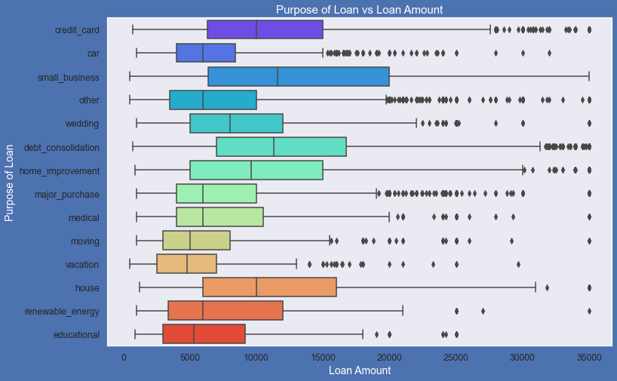
Key Points: 1.Median,95th percentile,75th percentile of loan amount is highest for loan taken for small business purpose among all purposes. 2.Debt consolidation is second and Credit card comes 3rd.

Slide 16
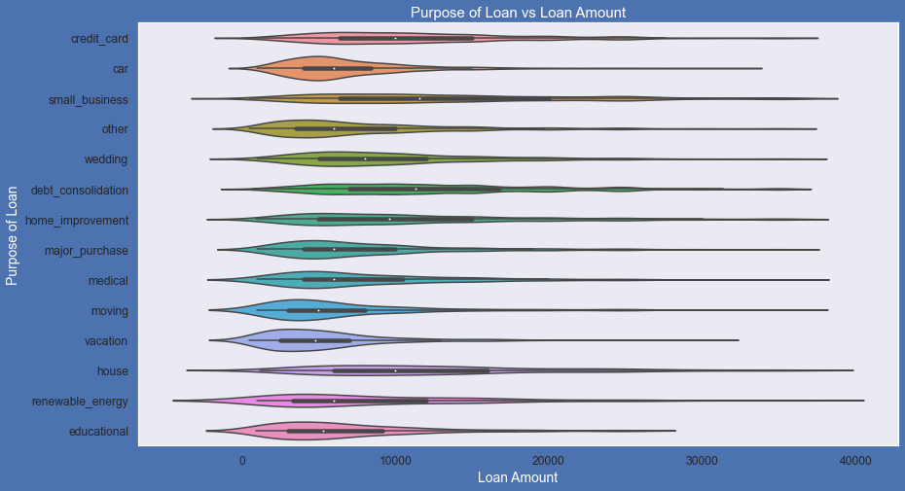
Violin Plot - It shows the distribution of quantitative data across several levels of one (or more) categorical variables such that those distributions can be compared. Here is the observation :- Loan taken for small business purpose, Debt consolidation and Credit card are somewhat evenly distributed as compare to loan taken for other purposes.

Slide 17
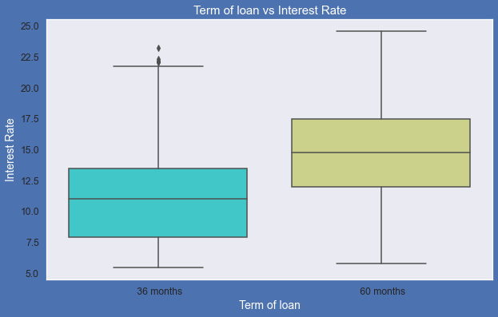
Term of loan vs Interest Rate observations: 1.It is clear that average interest rate is higher for 60 months loan term. 2.Most of the loans issued for longer term had higher interest rates for repayment.

Slide 18
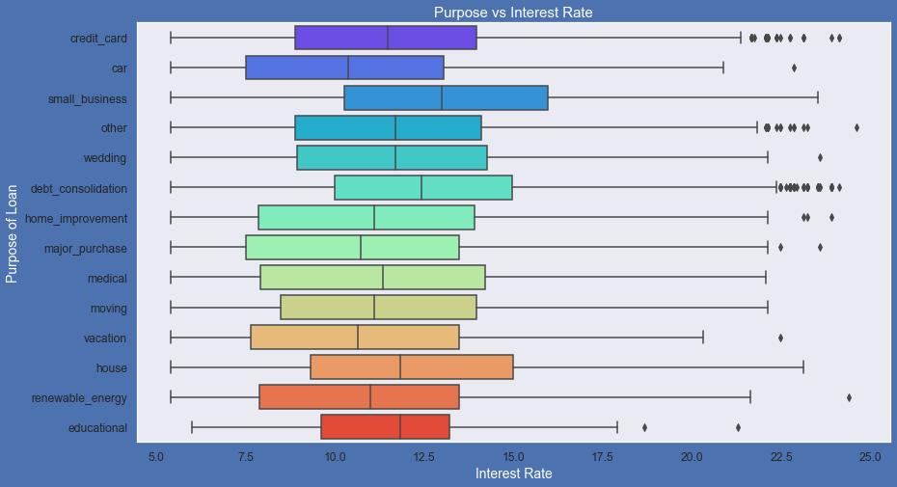
Purpose vs Interest Rate observations:
1. It is clear that average interest rate is highest for small business purpose.
2.Loans taken for small business purposes had to repay the loan with more intrest rate as compared to other.
3.Debt consolidation is 2nd where borrowers had to pay more interest rate.

Slide 19
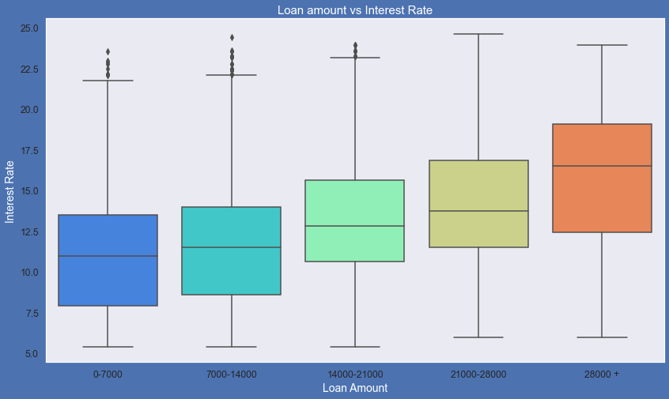
Loan Amount vs Interest Rate observations: 1. It is clear that interest rate is increasing with loan amount increase. 2. probably when loan amount is more it is taken for longer loan term, we saw earlier that longer the loan term more the interest rate.

Slide 20
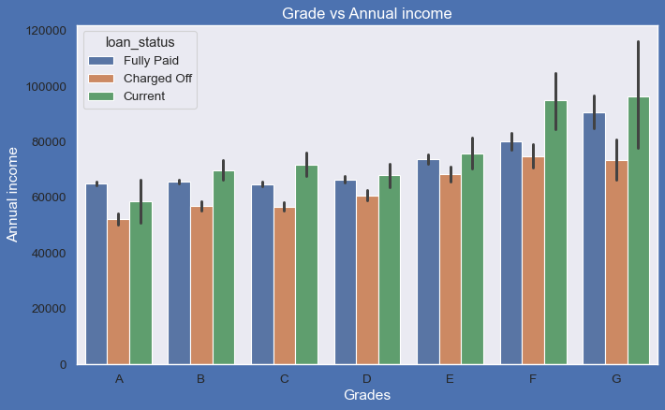
BarPlot to show variation of annual income across grade for every loan status From this we can conclude that the ones getting 'charged off' have lower annual incomes than the ones who 'paid fully' for each and every grade (i.e. at same interest range)

Slide 21
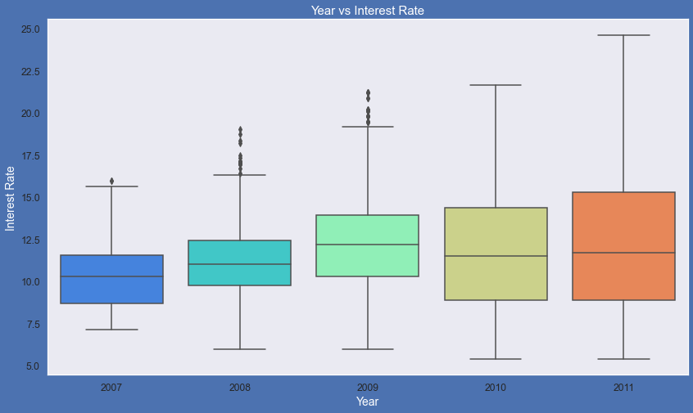
Box plot for year vs interest rate Plot shows interest rate is increasing slowly with increase in year.

Slide 22
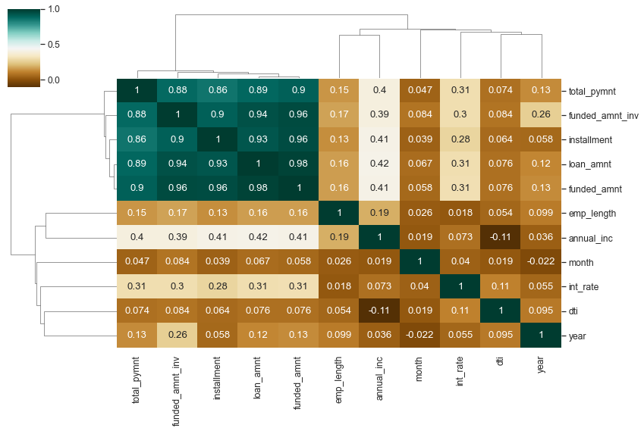
Correlation Matrix - Quantitative Variables :

Slide 23
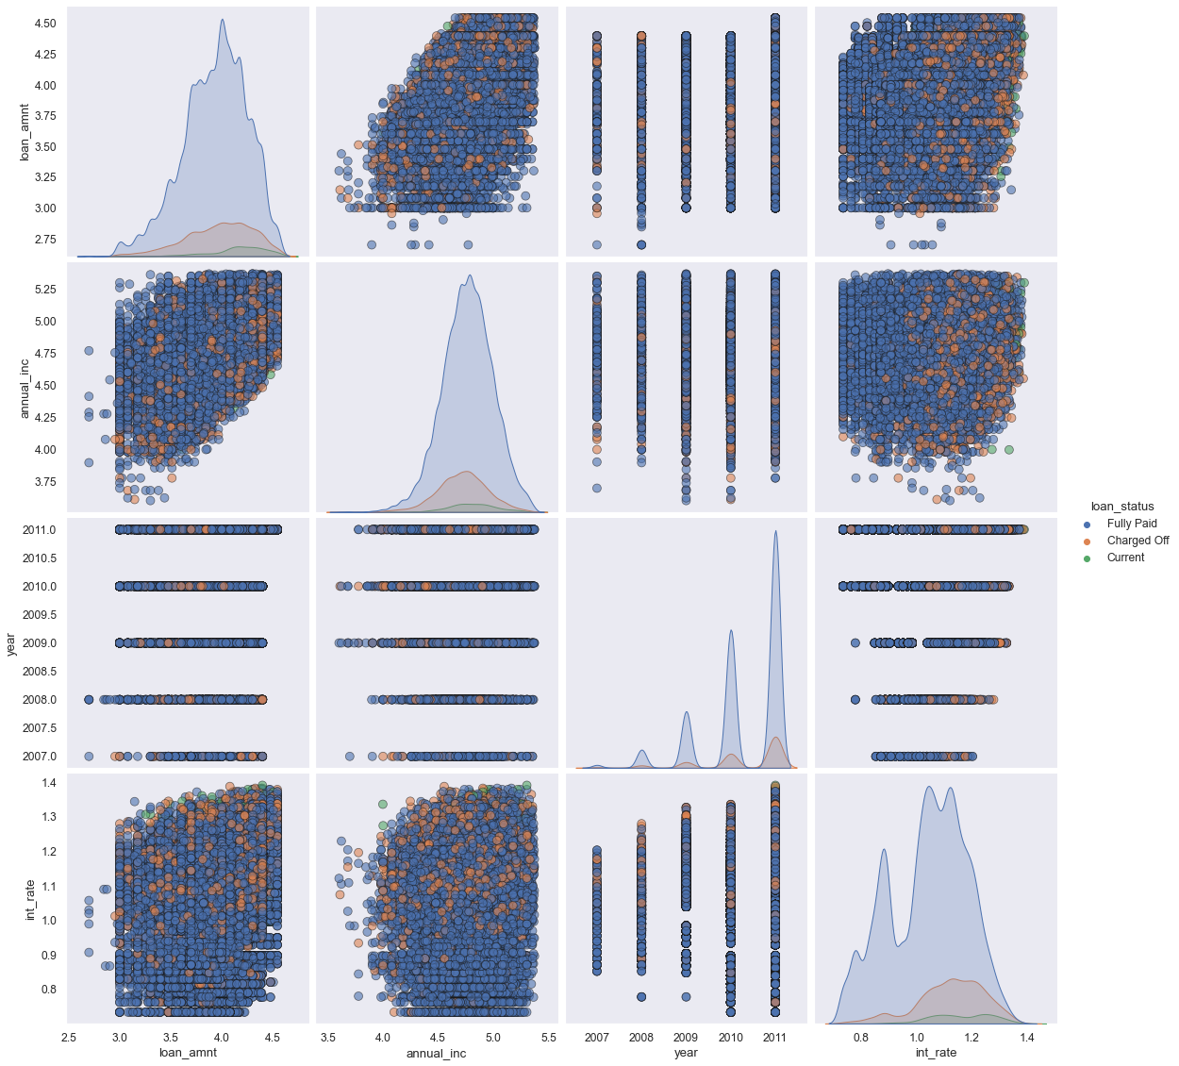
Multivariate Analysis - Pair Plots - 1
Higher interest rate higher charged off ration
Higher the annual income higher the loan amount slightly
Increase in number of charged off with increase in year
Interest rate is increase with loan amount increase

Slide 24
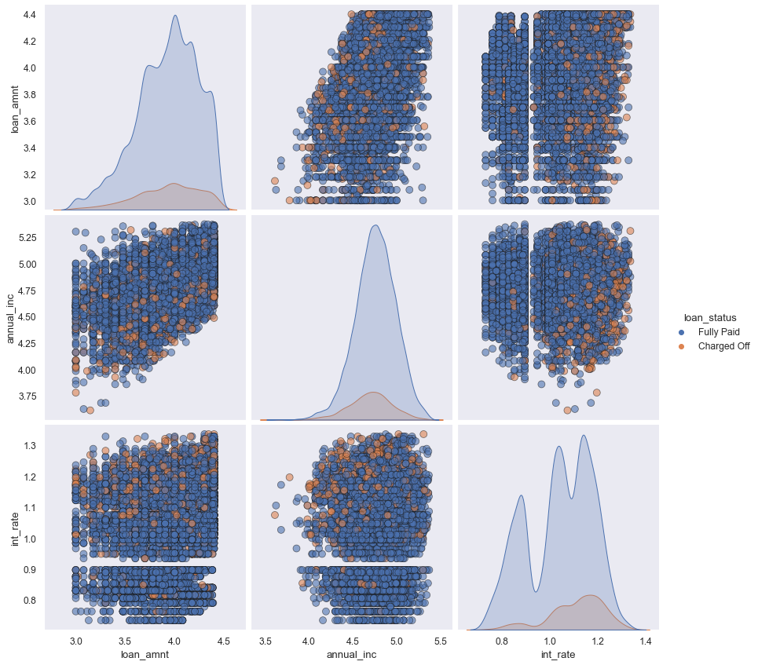
Plot-2
Higher the interest rate higher charged off ratio
Higher the annual income higher the loan amount slightly
Interest rate is increase with loan amount increase this result in high charged off

Slide 25
Total Loan Issued
debt_consolidation | 46.93
credit_card | 12.92
other | 10.05
home_improvement | 7.49
major_purchase | 5.51
small_business | 4.6
car | 3.9
wedding | 2.38
medical | 1.74
moving | 1.47
house | 0.96
vacation | 0.96
educational | 0.82
renewable_energy | 0.26

Slide 26
Conclusions
Observation is that loan amount, investor amount, funding amount are strongly correlated.
Annual income with DTI(Debt to income ratio) is negatively correlated.
Debt income ration is the percentage of a consumer monthly gross income that goes toward paying debts.
That means when annual income is low DTI is high & Vice versa
Positive Correlation between annual income and employment years
That means income increase with work experience.

